Slide 1
Android Application – Requirement Tracker
CS673 Group 3:
Initial Planning Phase
2/10/2016
Danny Chiu Macuei Mathiang
Brian Kabuye Ayodele Awoleye
ChihYung Wu Josh Wildey

Slide 2
Team Members
Danny Chiu
Team Leader|Requirement Leader|QA Leader
Brian Kabuye
Implementation Leader|Developer
ChihYung Wu
Design Leader|Developer
Macuei Mathiang
Security Leader|Tester
Ayodele Awoleye
Configuration Leader|Tester
Josh Wildey
Environment & Integration Leader|Tester

Slide 3
Project Tools
Primary communication: Slack
Documentation: Google Drive
Status Tracking: Pivotal Tracker
Programming Software: Android Studio
Version Control: GitHub
Backend/Database: Django database? (whatever will be used on the web version)

Slide 4
Main Objective
We want to create a functional Android application of the Requirement Tracker tool that is on the 3Blueprints website.

Slide 5
Essential Features
User Login Screen
Able to login/create an user account.
View list of different projects for each account
Logging in should bring user to main menu where all the projects associated with account will be listed.
Option to create and modify user stories.
Able to create new user story.
Able to edit/delete each data field.

Slide 6
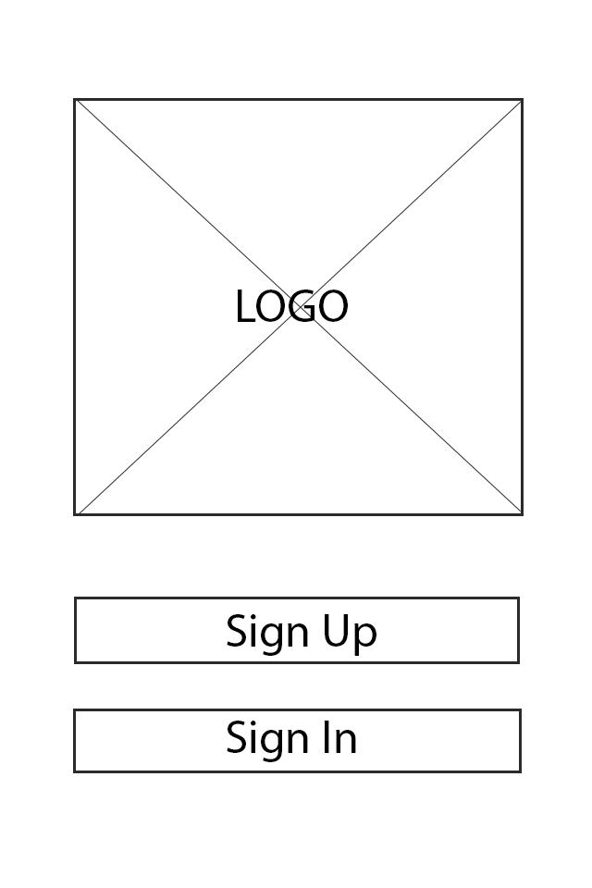
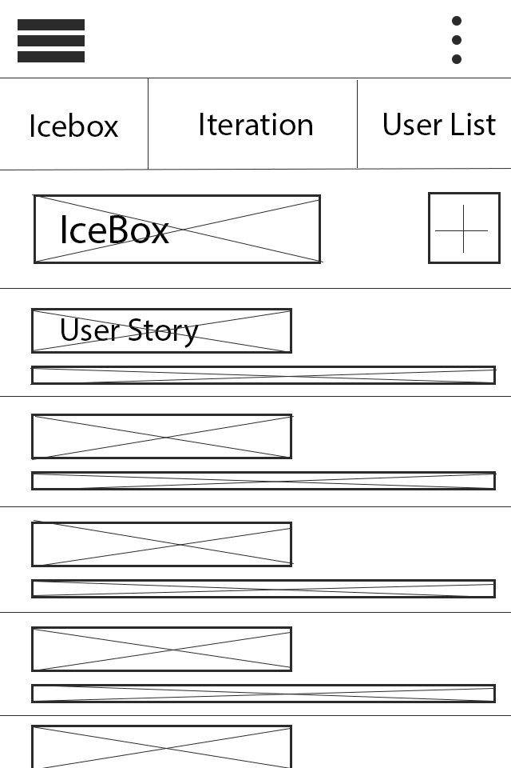
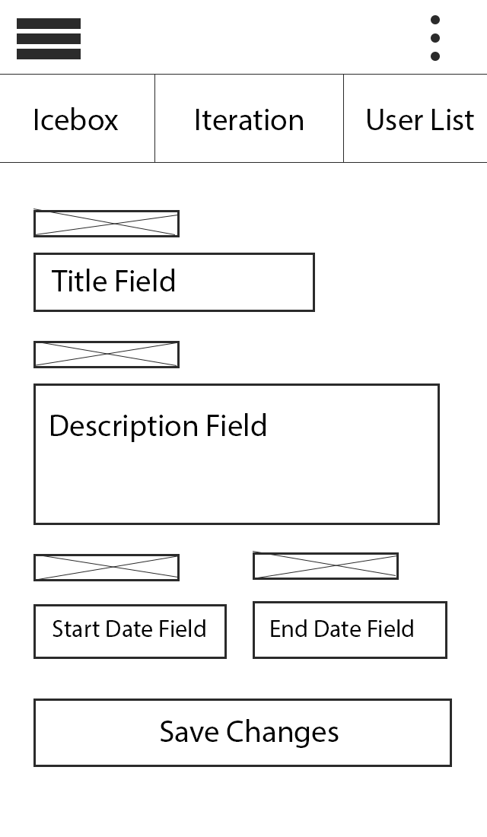
Rough Draft of User Interface Layout

Slide 7
Desirable Features
Different user groups have different permissions
Project manager – can add/delete projects
Programmers – can edit user stories
Customers – can add user stories
User stories are ranked so that most important ones are at the top of the list.

Slide 8
Optional Features
Communication Tool
Real-time chat
Issue/Bug Tracker
Ability to add new issues/bugs.
Ability to update status of the issues/bugs.

Slide 9
Management Plan
SCRUM model
Agile and iterative approach
Divide into three main iterations
Each iteration will last about 3 weeks.
Iteration 1:
Backend development – user login interface.
Iteration 2:
Functions to create user stories and modify them.
Iteration 3:
Ensure that Android application is functional.

Slide 10
Risk Management Plan
# | Risk Item | Probability of occurrence (%) | Risk Priority | Impact (s) on Project
1 | Loss of a team member | 15% | High | Difficult for his role to be replaced and delaying of project
2 | Missing delivery deadline(s) | 14% | High | Losing customer and reputation $$ OR (Bad grades!
3 | Source code loss/server down | 5% | Low | Failing project
4 | Failing to meet the three essential features | 10% | Medium | Poor quality project
5 | Malware attacks | 7% | Medium | * Application data loss/stolen or corruption * Unauthorized access * DoS (Denial of access) to application
6 | Difficulty integration work | 8% | Medium | * Nonworking application

Slide 11
# | Risk Item | Probability of occurrence (%) | Risk Priority | Impact (s) on Project
7 | Broken authentication and session Id | 7% | Medium | * Unauthorized access and other security risks
8 | Compatibility with all android device (hardware & software) | 4% | Low | Less customers == less money $$
9 | Customer change project requirements (+/-) | 5% | Low | additional resources (time and effort) needed
10 | Overriding other people’s work by not having the latest versions of code | 3% | Low | Bad practice that could lead to nonfunctioning code.
11 | Lack of exposure to and or experience with technologies | 7% | Medium | Poor quality application
12 | Being overwhelmed by work in other classes | 15% | High | Withdraw from class/ Putting less effort on this assigned task (S)

Slide 12
Response/Action Plan:
# | Risk Item | Response/Action Plan for Risk (Risk Management Technique)
1 | Loss of a team member | Assure file are uploaded and integrated consistently, and use pair programming to understand each other’s work.
2 | Missing delivery deadline(s) | Always check during Scrum meeting that project is on track and plan more time for debugging/Testing
3 | Source code loss/server down | Have 3 backup sources code in 3 different locations. How reliable are our storage? It host often
4 | Failing to meet the three essential features | In each of our iterations we should make sure that we are working towards the essential features.
5 | Malware attacks | Follow modern application security best practices and standards. Use Mobile Application Security Vulnerabilities Scanners like AppScan by IBM OR WebInspect by HP OR AppVigil Mobile Vulnerabilities scanner.
6 | Difficulty integration work | Increase communication and integrate often

Slide 13
# | Risk Item | Response/Action Plan for Risk (Risk Management Technique)
7 | Broken authentication and session Id | Employ strong hashing and encryption algorithm when dealing with sensitive data like personal data (UN, PW, Profile information). Enforce strong authentication logic , strong username and password policy Do not send session id on URL header, but add it into body of POST.
8 | Compatibility with all android device (hardware & software) | Test compatibility of our application with all available recent android devices (tablets/mobile)
9 | Customer change project requirements (+/-) | Following Agile process few requirement modification should be possible.
10 | Overriding other people’s work not having the latest versions of code | Version control program - GitHub Configuration leader and team lead will make sure this risk is well managed.
11 | Lack of exposure to and /or experience with technologies | Currently most members of our team are learning Android technologies since only 3 members who work with Android before.
12 | Being overwhelmed by work in other classes | Communicate early when members are overwhelmed with other work, so other members can help out.

Slide 14
Process Improvement/Lessons Learned
Good communication is very important!
In-person meetings
E-mail/Slack are good, but doesn’t replace above.
Tasks should be well-defined!
Action list every week moved project forward.
Status updates are important.
There needs to be a better way to track progress.
Check-in with group to talk about what each member has done throughout the week.

Slide 15
Process Improvement Part 2
How to improve process for Iteration 1?
Have more concrete/well-defined action items to do every week.
Mid-week meeting so that everyone can give a status update on their task and discuss about any issues they are having.
Focus on communication – check-in to make sure everyone understands their roles and responsibilities.

Slide 16
References
CS673 SE Spring 2016 lectures (Requirements, Security Process, Quality Assurance & Risk management ).
AppVigil Vulnerability Scanner
https://appvigil.co/en/mrps/app-vulnerability-scanner/

